Slide 1
Magrathean* Project Management
Greg Barr
Principal
DawnTreader / WorldBuilders
April 2016
*homage to Douglas Adams, The Hitchhiker’s Guide to the Galaxy (BBC Radio, 1978)

Slide 2
An Exoplanetary World building Project Management Life Cycle
Initiation: Contact: Cultures of the Imagination Conference
Planning: A Solar System for 82 Eridani
Planning: Conference developments
Execution: How to sustain development after the Conference
Execution and Monitoring: Newsletters for participants
Execution: Second Contact Conference
Execution: Second year developments and Third Conference
Close-Out: World Science Fiction Presentation & Publication
Video & Web site

Slide 3
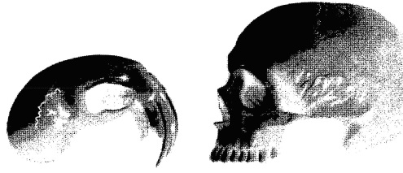
Contact: Cultures of the Imagination
“Cultures Of The Imagination is an experiment in creation -- participants design an integrated world, alien and its way of life, and simulate contact with a future human society.” – Jim Funaro, Founder
A tradition of building alien worlds and sentient species
1st Conference – April 1983 - now in its 29th year
http://contact-conference.com/
Two teams, an Alien Team and a Human Team, work independently to create future scenarios that lead to an eventual “Contact.”

Slide 4
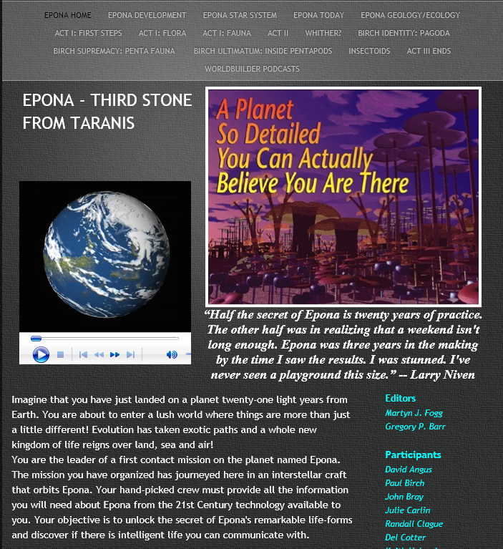
Epona Project Vision
Epona was born after CONTACT's annual gathering in 1992. An international team, headed by Martyn Fogg and Greg Barr, embarked upon a three-year project and has produced a wondrously rich and exotic world. Epona is quite likely one of the most thoroughly researched imaginary worlds ever created.
It started with Fogg’s Silicon Creation software that modeled possible planetary configurations for different star masses.

Slide 5
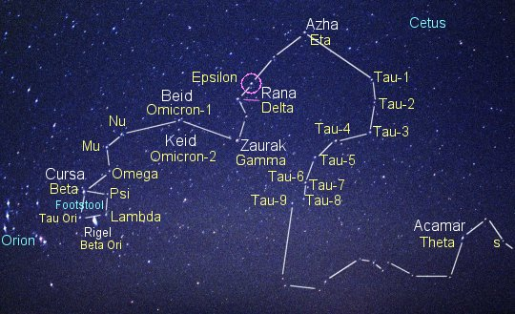
Planning and Subsequent Reality Silicon Creation and Actual Exoplanets
1991 Speculation using an application that based its calculations on stellar mass using known physical laws to plot possible ways a planetary system could build-up around stellar masses.
2000 Reality – a planet 1.5 times the size of Earth has been discovered orbiting Epsilon Eridani. A K2 dwarf star about 8 light years closer to Earth than 82 Eridani.

Slide 6
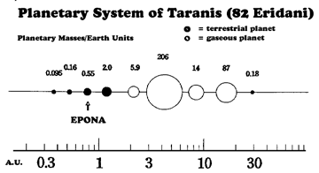
Real Star - Hypothetical Planetary System
82 Eridani
This G8 star is slightly smaller and less massive than the Sun, making it marginally dimmer than the Sun in terms of luminosity; about 20% more luminous than Tau Ceti or Alpha Centauri B. The projected equatorial rotation rate (v sin i) is 4.0 km/s,[9] compared to 2 km/s for the Sun.
Silicon Creation software output

Slide 7
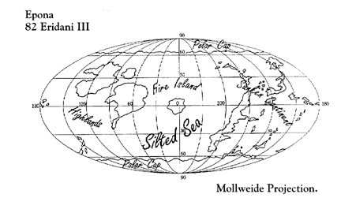
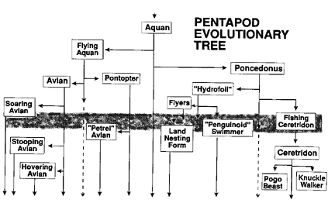
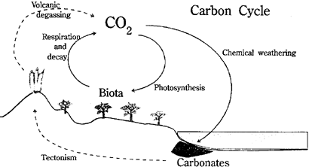
Execution - Contact X: Feb. 1993, Santa Clara CA
Martyn Fogg presented a paper called: The Ecosphere - On the Prevalence of Habitable Planets
A team of self-selecting conference attendees began work on building an alien world for 82 Eridani’s hypothetical third planet

Slide 8
Execution: After Conference World Building
Call for Participants
May 1993: Distribution of an initial newsletter (issue #0) to the Contact mailing list (~200)
June 1993: Issue #1 – 27 respondents
16 page booklet on the solar system and details on the third planet.
Oct. 1993: Issue #2 – Summary of flora and fauna to date, naming of the star and planets (Taranis & Epona)
Participant Categories (now 46):
Sophonts (5)– copyright & contribution
Lurkers Ascending (6)– copyright but
no contribution
Bottom Dwelling Lurkers (35) – just
recipients

Slide 9
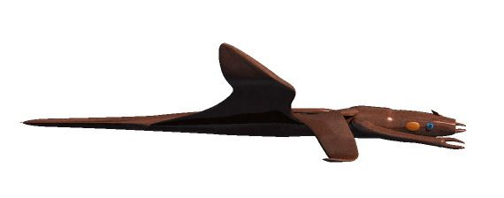
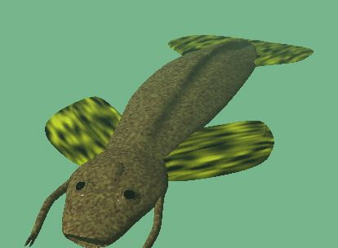
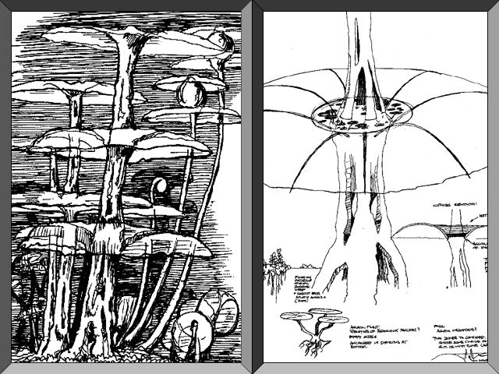
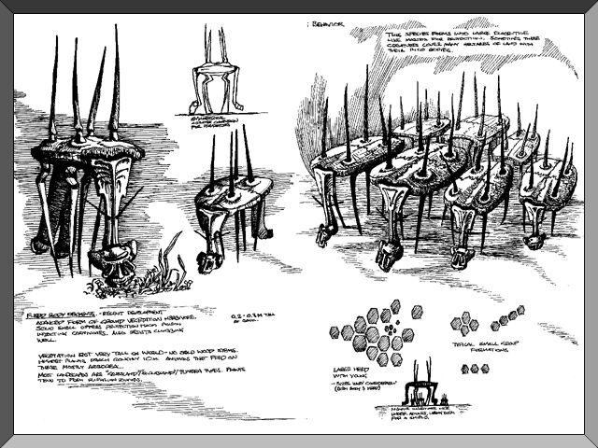
Monitoring: January 1994 onwards
Newsletter Issue # 3
Maintaining a collaborative and evolutionary process
Paul Birch’s massive contribution on vegetation and an Avian creature that thrives on it
Detailed respiratory, circulatory, muscular and skeletal drawings and the creation of an innovative muscle boost chemistry
Wolf Read’s Insectoid population – detailed drawings of exoskeletal creatures
Most updates received via email

Slide 10
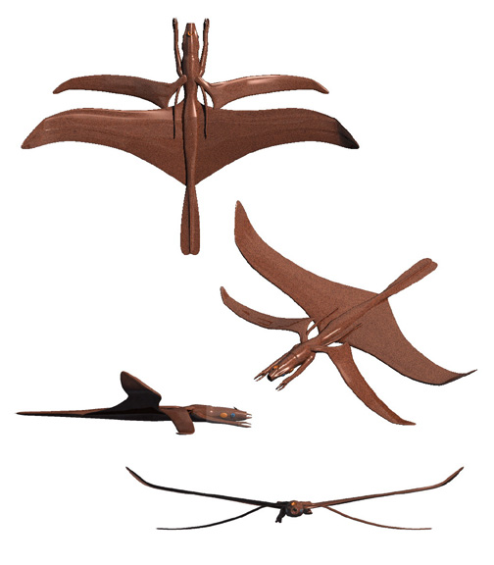
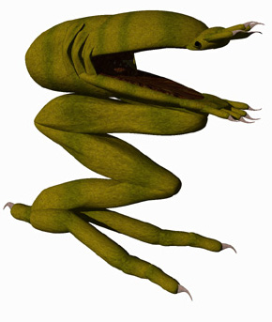
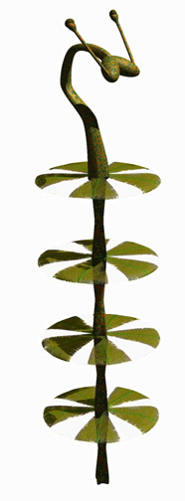
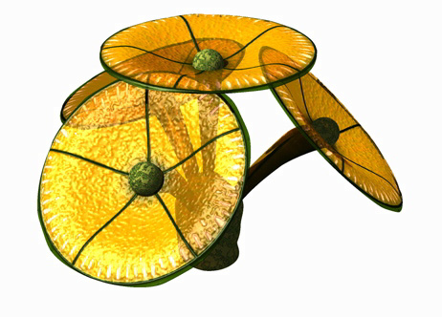
Contact XI: March 1994
Emerging Sophont: Uthers
An intelligent being; a being with a base reasoning capacity roughly equivalent to or greater than that of a human being.
Term sophont first “coined” by Karen Anderson and used by Poul Anderson in his 1966 novels.

Slide 11
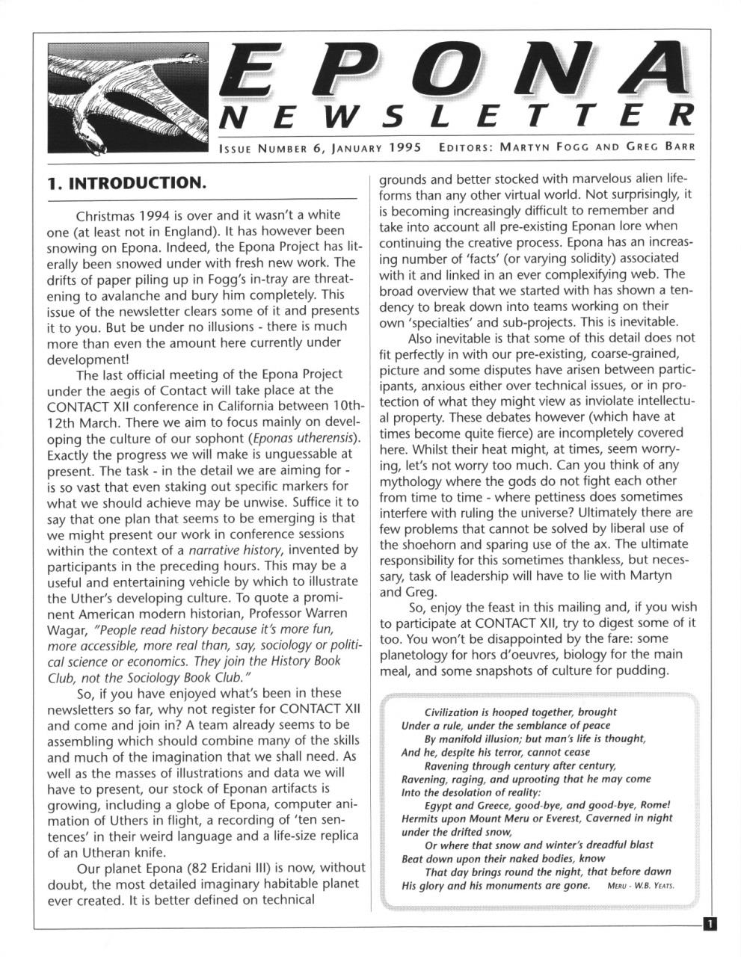
Final Newsletters: Oct. 94 & Jan. 95
Climate
John Bray’s paper “The Climate of Epona” submitted as part of a UK Met Office’s Meteorology for Graduates course in 1994.
Geography
Naming the regions (Celtic terms in keeping with the planetary system)
Tir fo Thuinn – The Sunken Continent: detailed flora and fauna in a 24 page paper collated by a sub group that met for several months on the West Coast (San Francisco Bay Area)
Uther Culture: essays on Religion and War

Slide 12
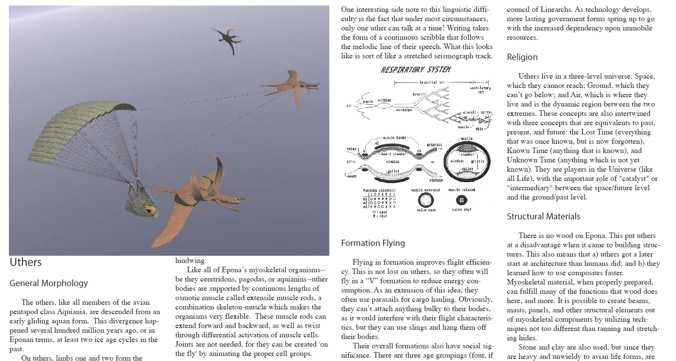
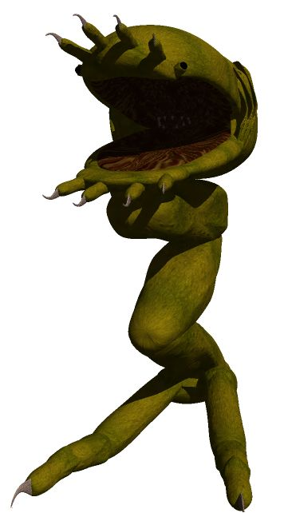
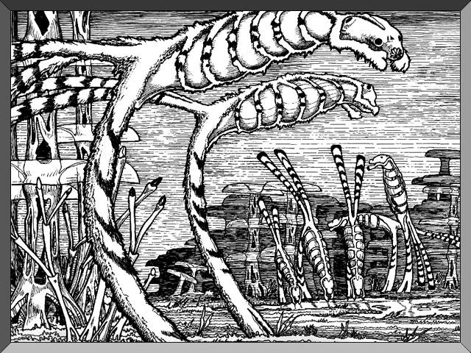
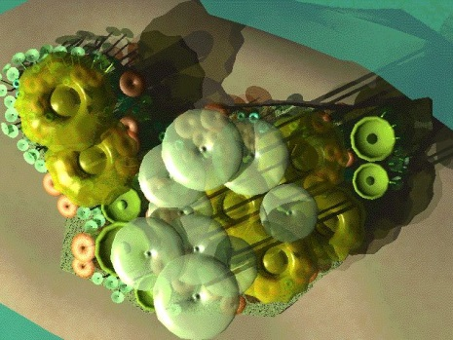
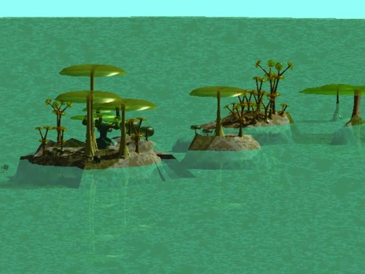
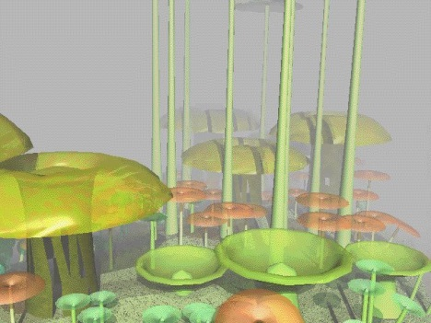
Contact XII: March 1995
Final Conference for Epona
General Assembly Presentations
Workshops
Final day presentation
1 ½ hour panel
AV presentations
Overall Final Participation
Over 60 recipients
31 contributors

Slide 13
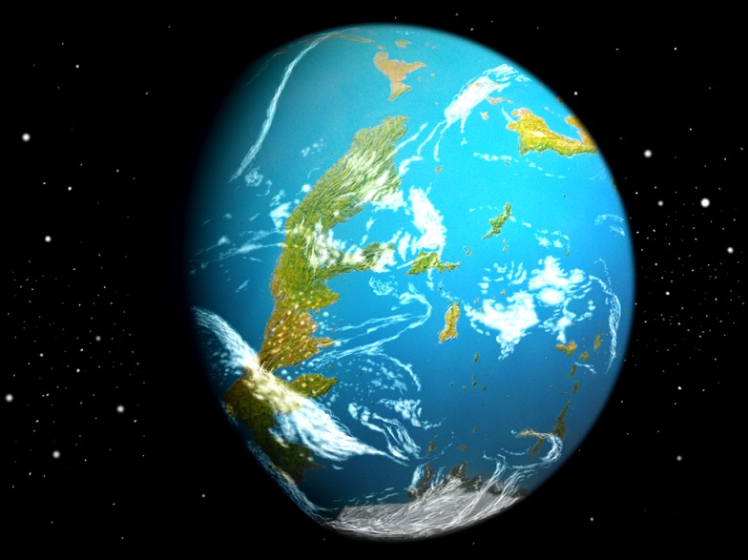
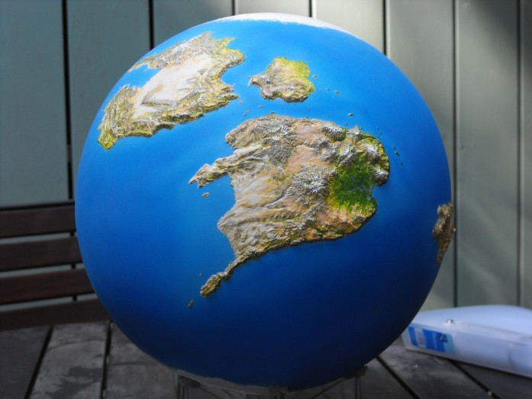
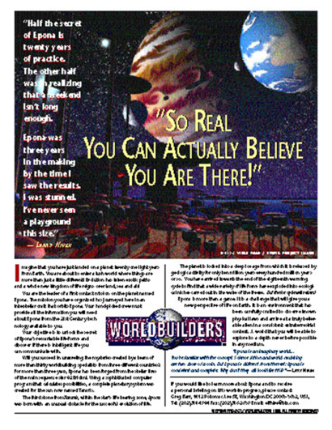
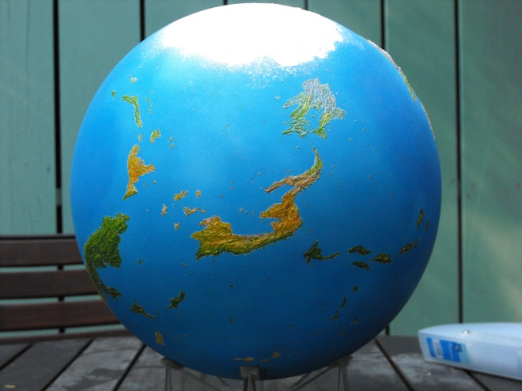
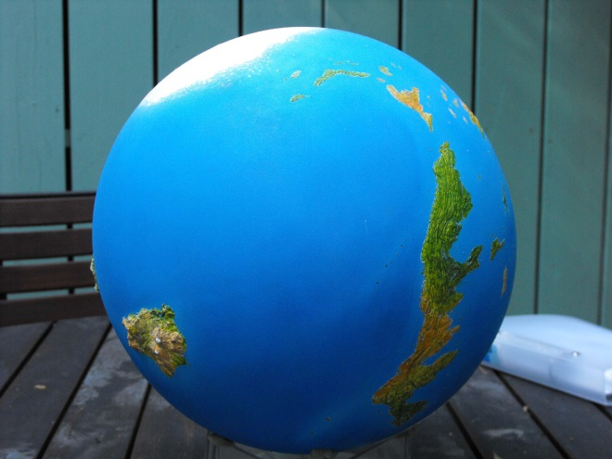
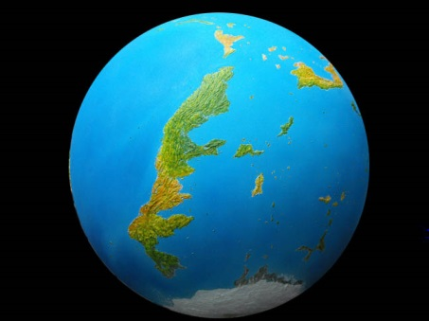
Glasgow, August 1995: Intersection Project Close Out
Exhibit in the central hall throughout the four day World Science Fiction Convention
Two hour presentation with speakers, video and Uther artifacts
Web Site
Mailing List
Epona 12” physical globe created by David Angus
http://www.daplanets.co.uk/

Slide 14
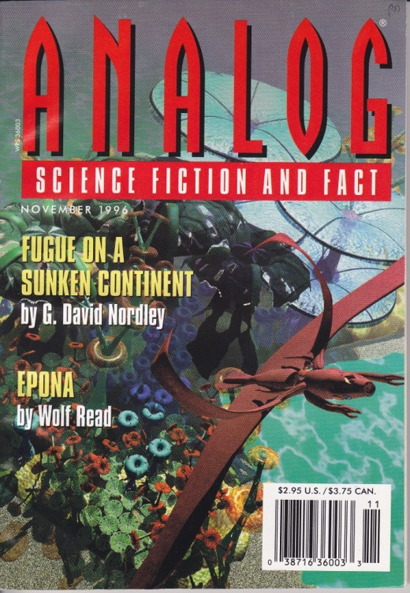
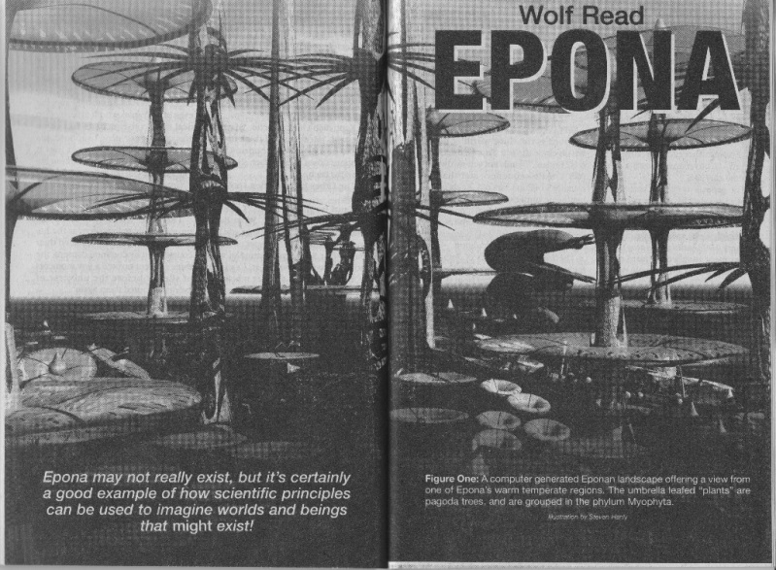
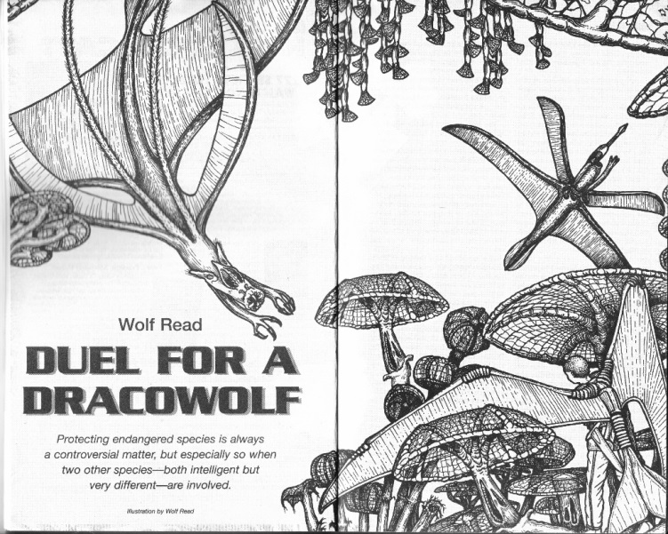
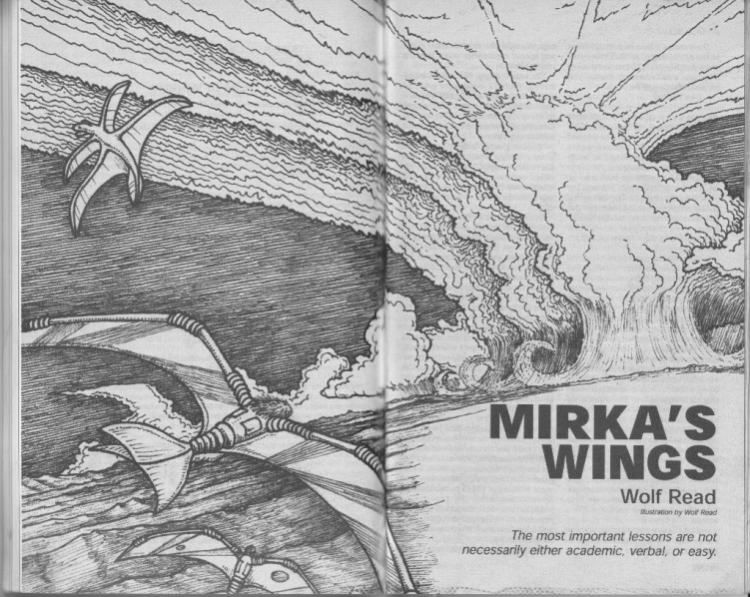
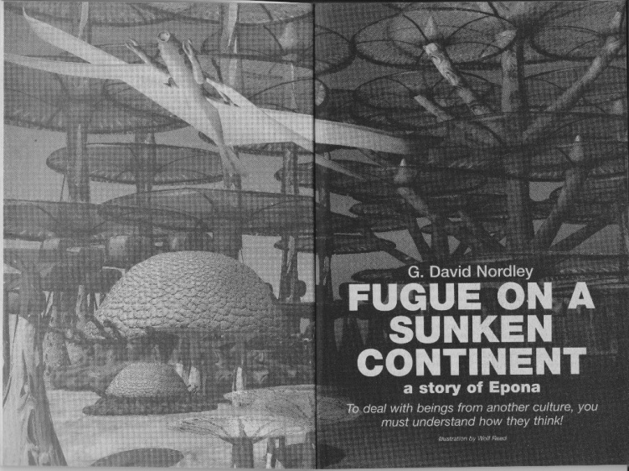
Project Close-out: Publication
Epona stories in Analog Science Fiction and Fact:
Nov. 1996
details on Epona in a special fact feature by Wolf Read
and a novella, “Fugue on a Sunken Continent,” by G. David Nordley.
Nov. 1998 – a novelette by Wolf Read, “Duel for a Dracowolf.”
Feb. 2001 – a novelette by Wolf Read, “Mirka’s Wings.”

Slide 15
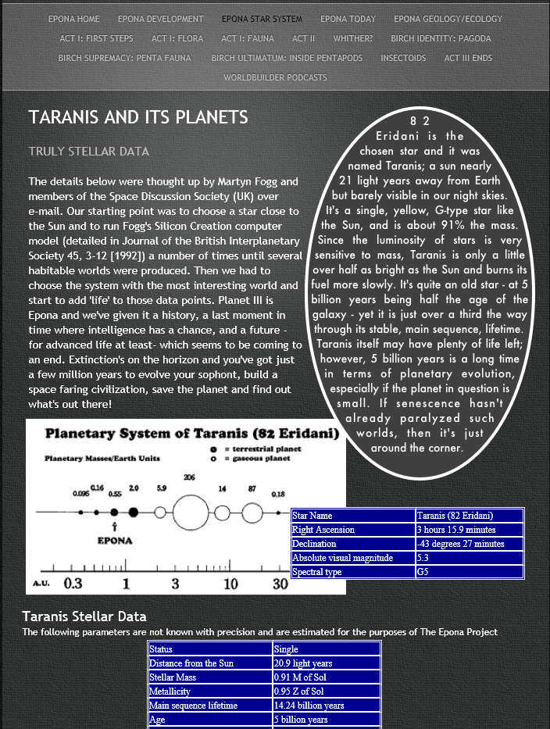
Epona Reconnaissance Flight
Video created by Steven Hanly and Gert van Dijk
Digital artwork in this presentation by Steven Hanly
Additional artwork by Wolf Read
You can view more of Epona’s early development at: www.eponaproject.com
video

